Slide 1
E-COMMERCE PERFORMANCE REVIEW
From Raw Orders to Boardroom Insights
Data Analytics Project 4 — Data Visualization & Storytelling
Author: Eman Iqbal | Batch 2026 | Powered by DecodeLabs
1,200 Orders Analyzed • 3-Task Analytics Pipeline • 8 Executive Visualizations

Slide 2
SITUATION
A Full Year of Trading Across 1,200 Orders
Baseline snapshot before we identify what changed and why.
1,200
$1.26M
$1,054
5
Total Orders
Total Revenue
Avg. Order Value
Referral Channels
2023 – 2025
All channels combined
Across all coupons
Instagram, Email, Google, Facebook, Referral
Everything on the following slides answers one question: where is this performance heading, and what should we do about it?
DecodeLabs | E-Commerce Analytics — Project 4
2

Slide 3
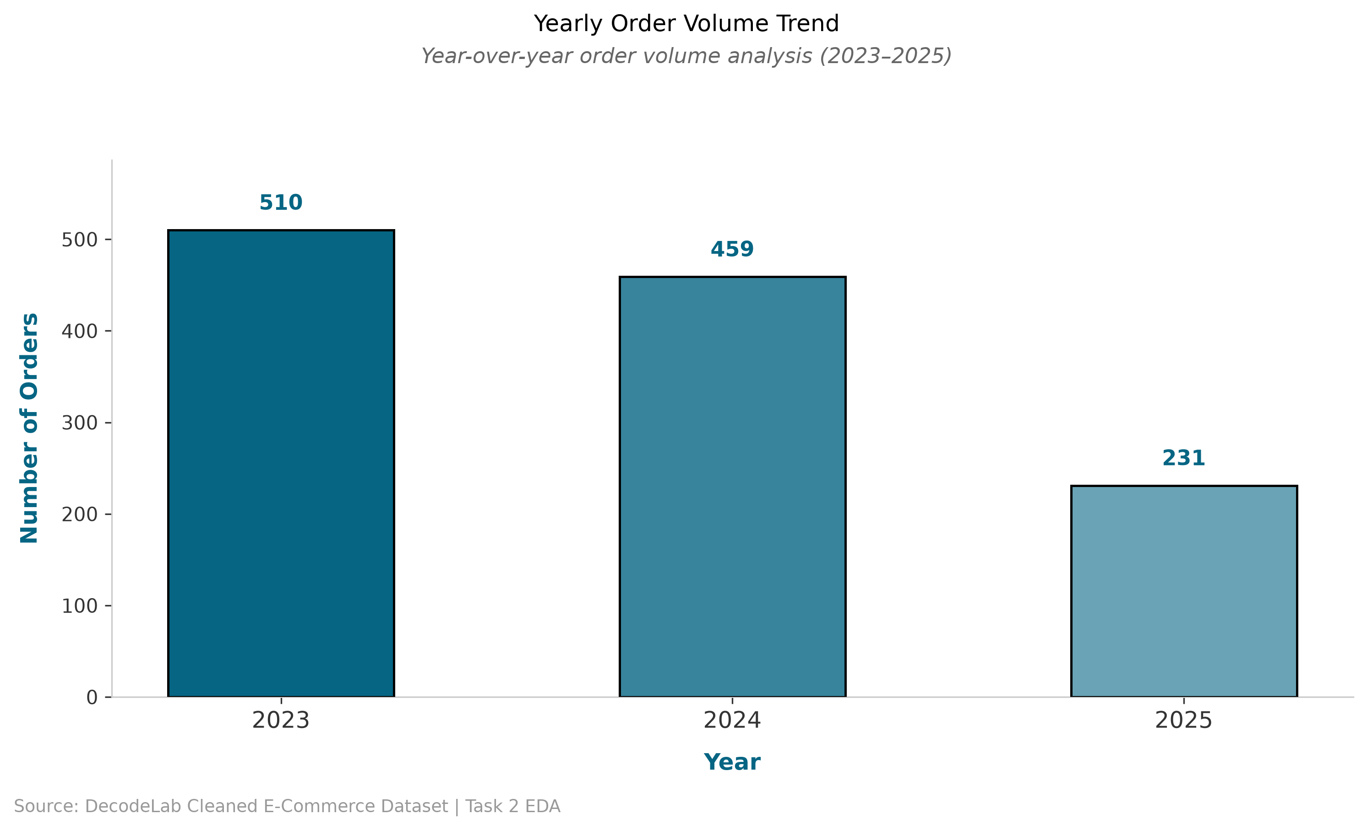
COMPLICATION
Order Volume Has Fallen 55% Since 2023
Growth has not just slowed — it has reversed for two straight years.
Why this matters
2025 is a partial year in this dataset, so the drop is steeper on paper —
but the 2023→2024 decline (510 → 459) is already a real, full-year signal.
So What?
Treat 2025 as an early warning, not noise. The retention and referral issues on the next slides help explain the trend.
DecodeLabs | E-Commerce Analytics — Project 4
3

Slide 4
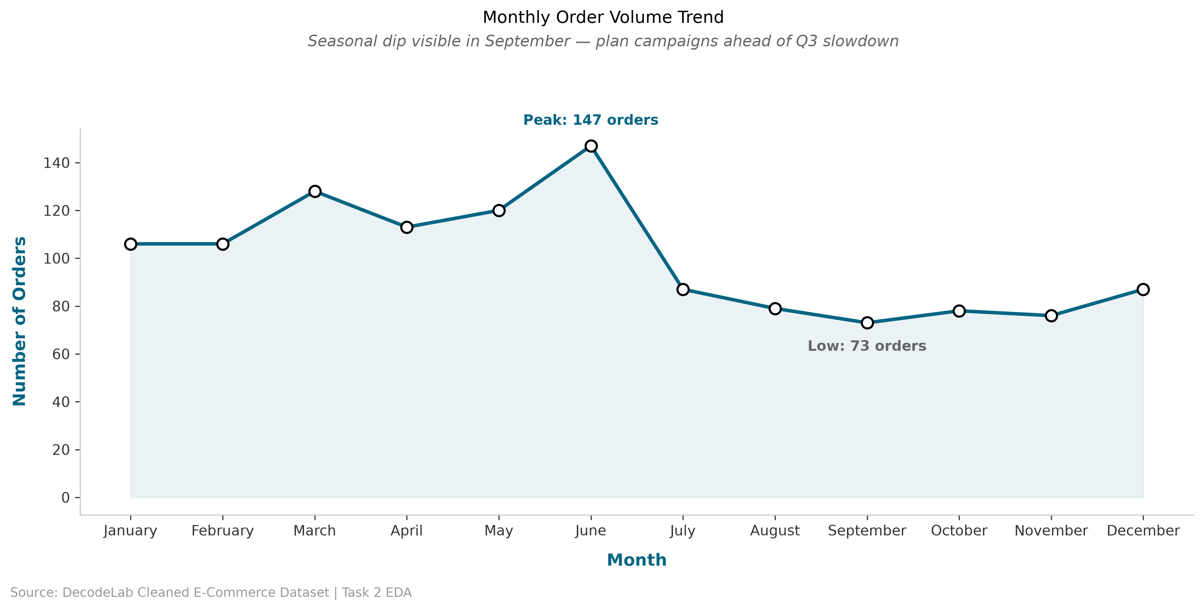
COMPLICATION
Orders Collapse Every Year Once Q3 Begins
Volume halves between June's peak and September's low — a predictable, recurring pattern.
DecodeLabs | E-Commerce Analytics — Project 4
4

Slide 5
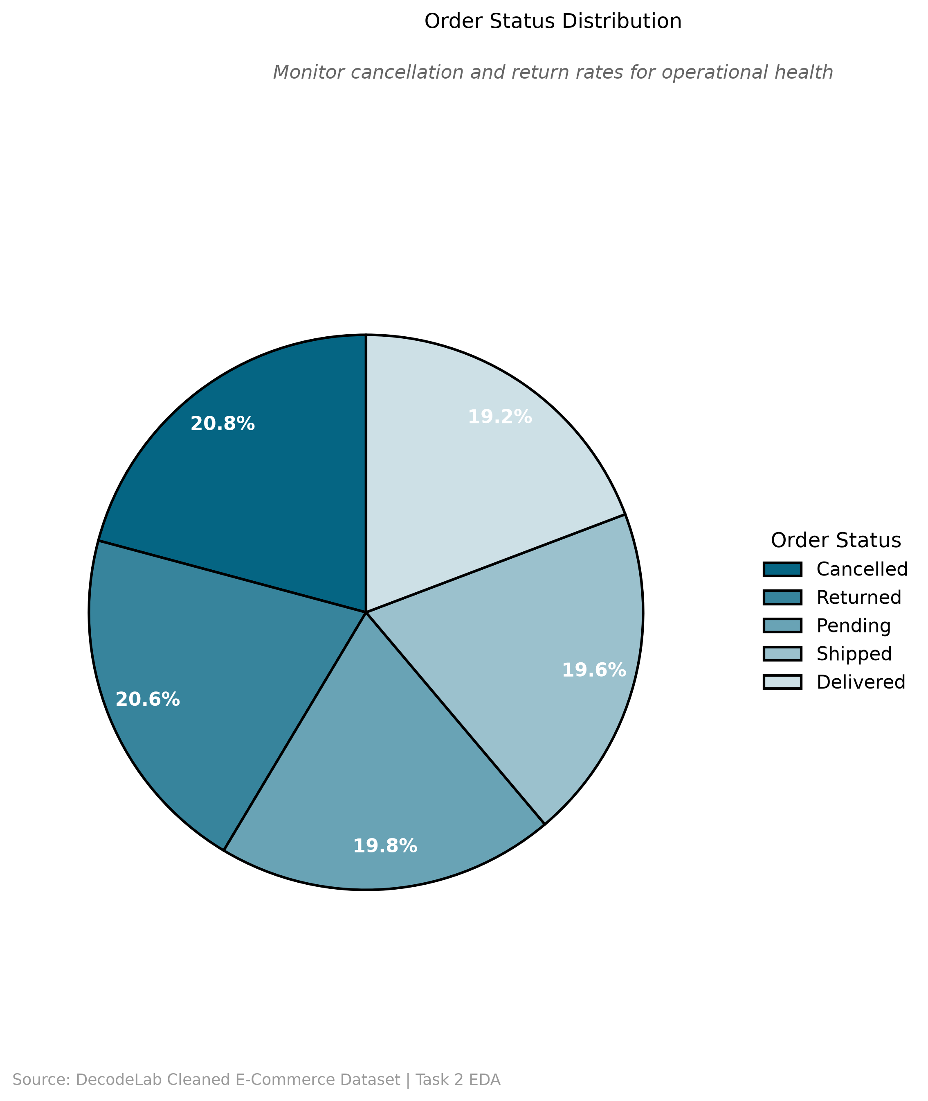
COMPLICATION
41% of Orders Are Cancelled or Returned
That failure rate is quietly erasing more than a third of total revenue.
$519,674
Revenue lost to Cancelled + Returned orders
(41.1% of $1.26M total revenue)
So What?
This is the single largest value-recovery opportunity in the dataset.
Even a 5-point reduction in the combined Cancelled + Returned rate would recover an estimated $63,000+ in revenue.
Recommended next step: audit checkout friction and post-purchase quality for the top 2 affected products.
DecodeLabs | E-Commerce Analytics — Project 4
5

Slide 6
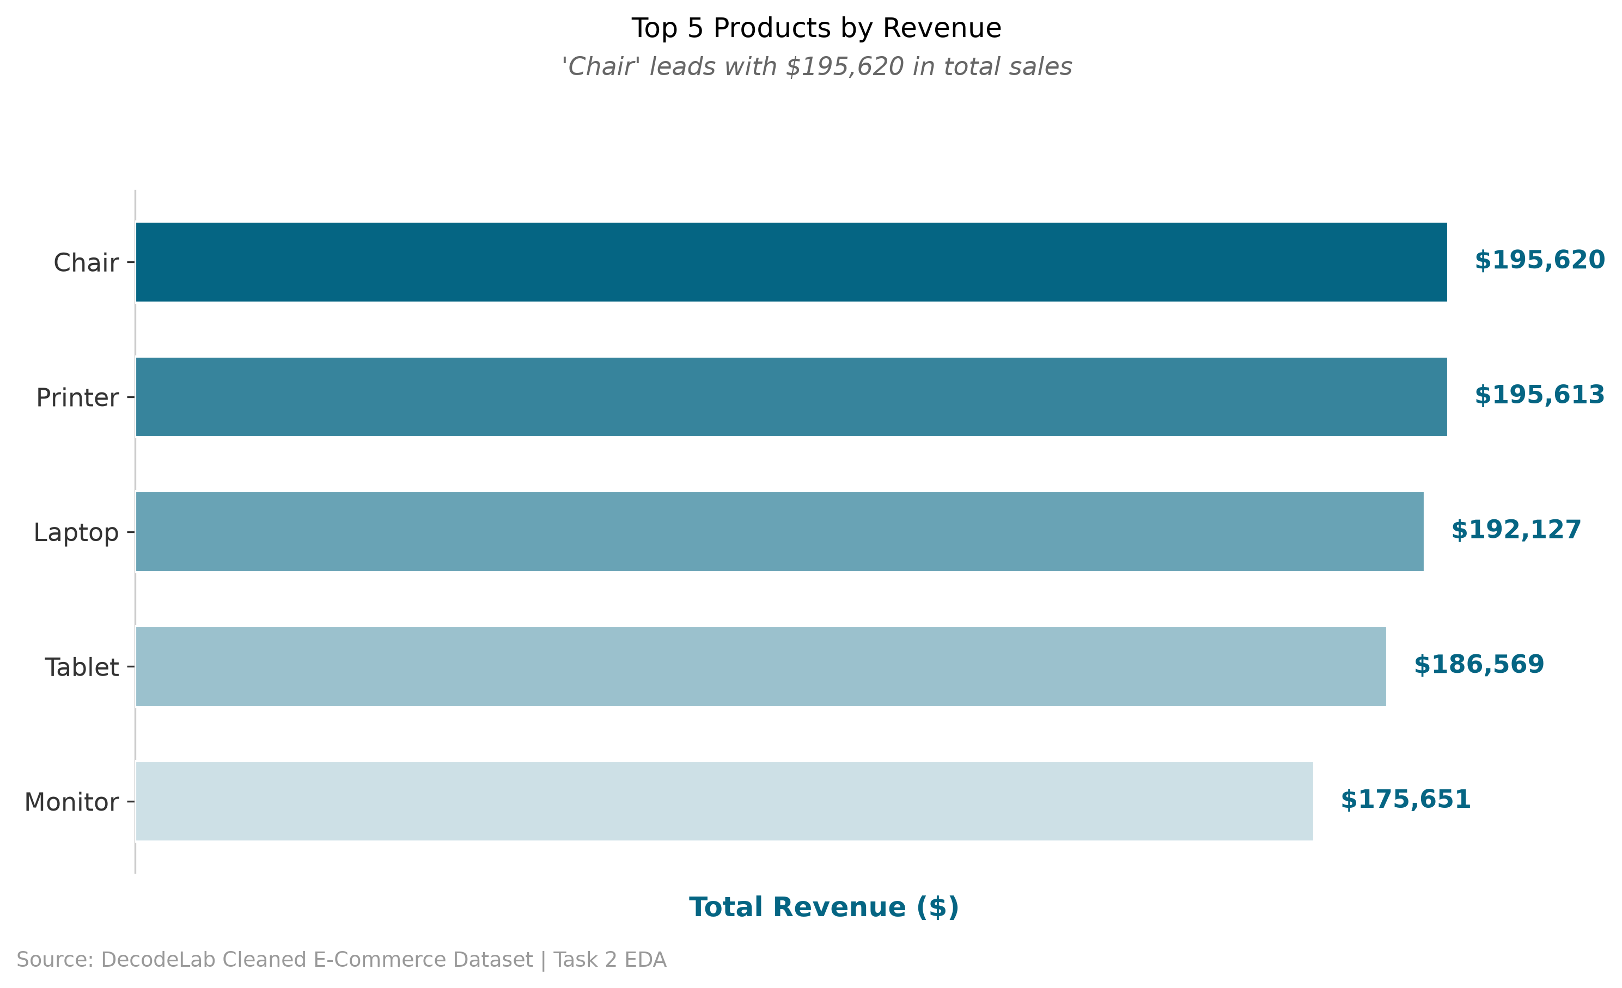
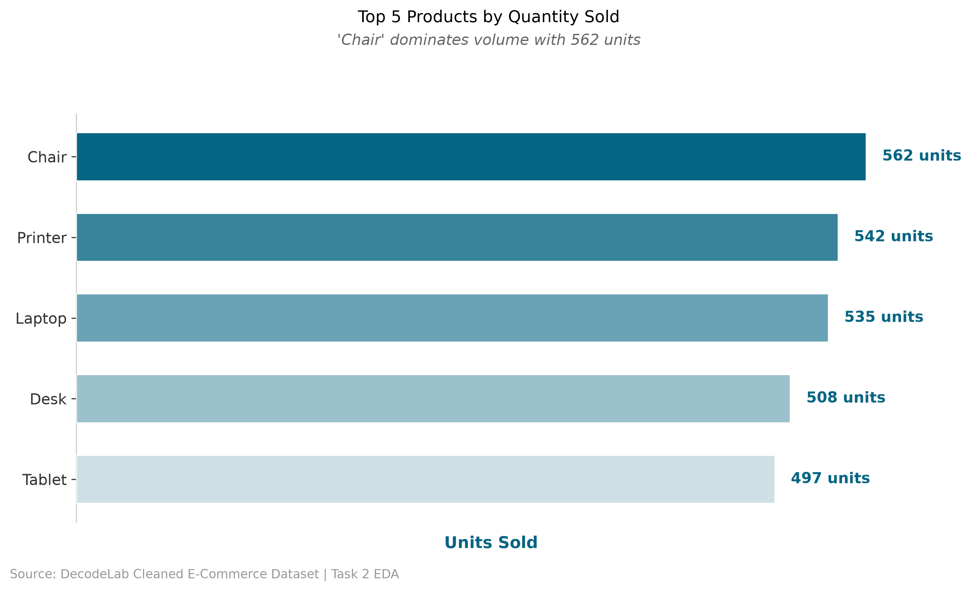
ANALYTICAL NEED: COMPARISON
Chair Leads, But the Top 3 Products Are Nearly Tied
Chair, Printer, and Laptop sit within $3,500 of each other in revenue — no single hero product.
So What? Inventory and marketing budgets should treat Chair, Printer, and Laptop as a co-equal “core three” rather than over-indexing on a single flagship SKU.
DecodeLabs | E-Commerce Analytics — Project 4
6

Slide 7
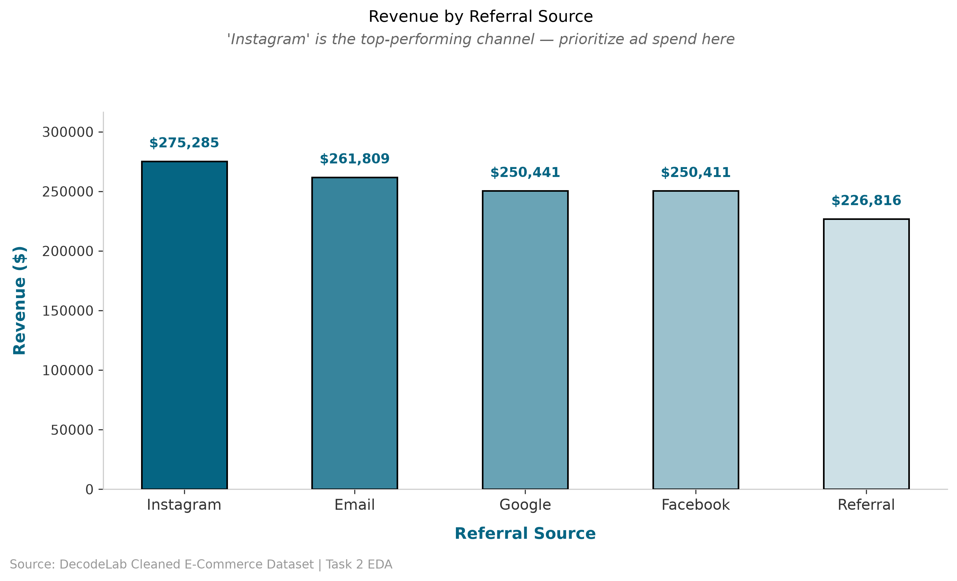
ANALYTICAL NEED: COMPARISON
Instagram Is the Top Revenue Channel — by $13K
Every channel is within striking distance — this is a lead to extend, not a runaway win.
DecodeLabs | E-Commerce Analytics — Project 4
7

Slide 8
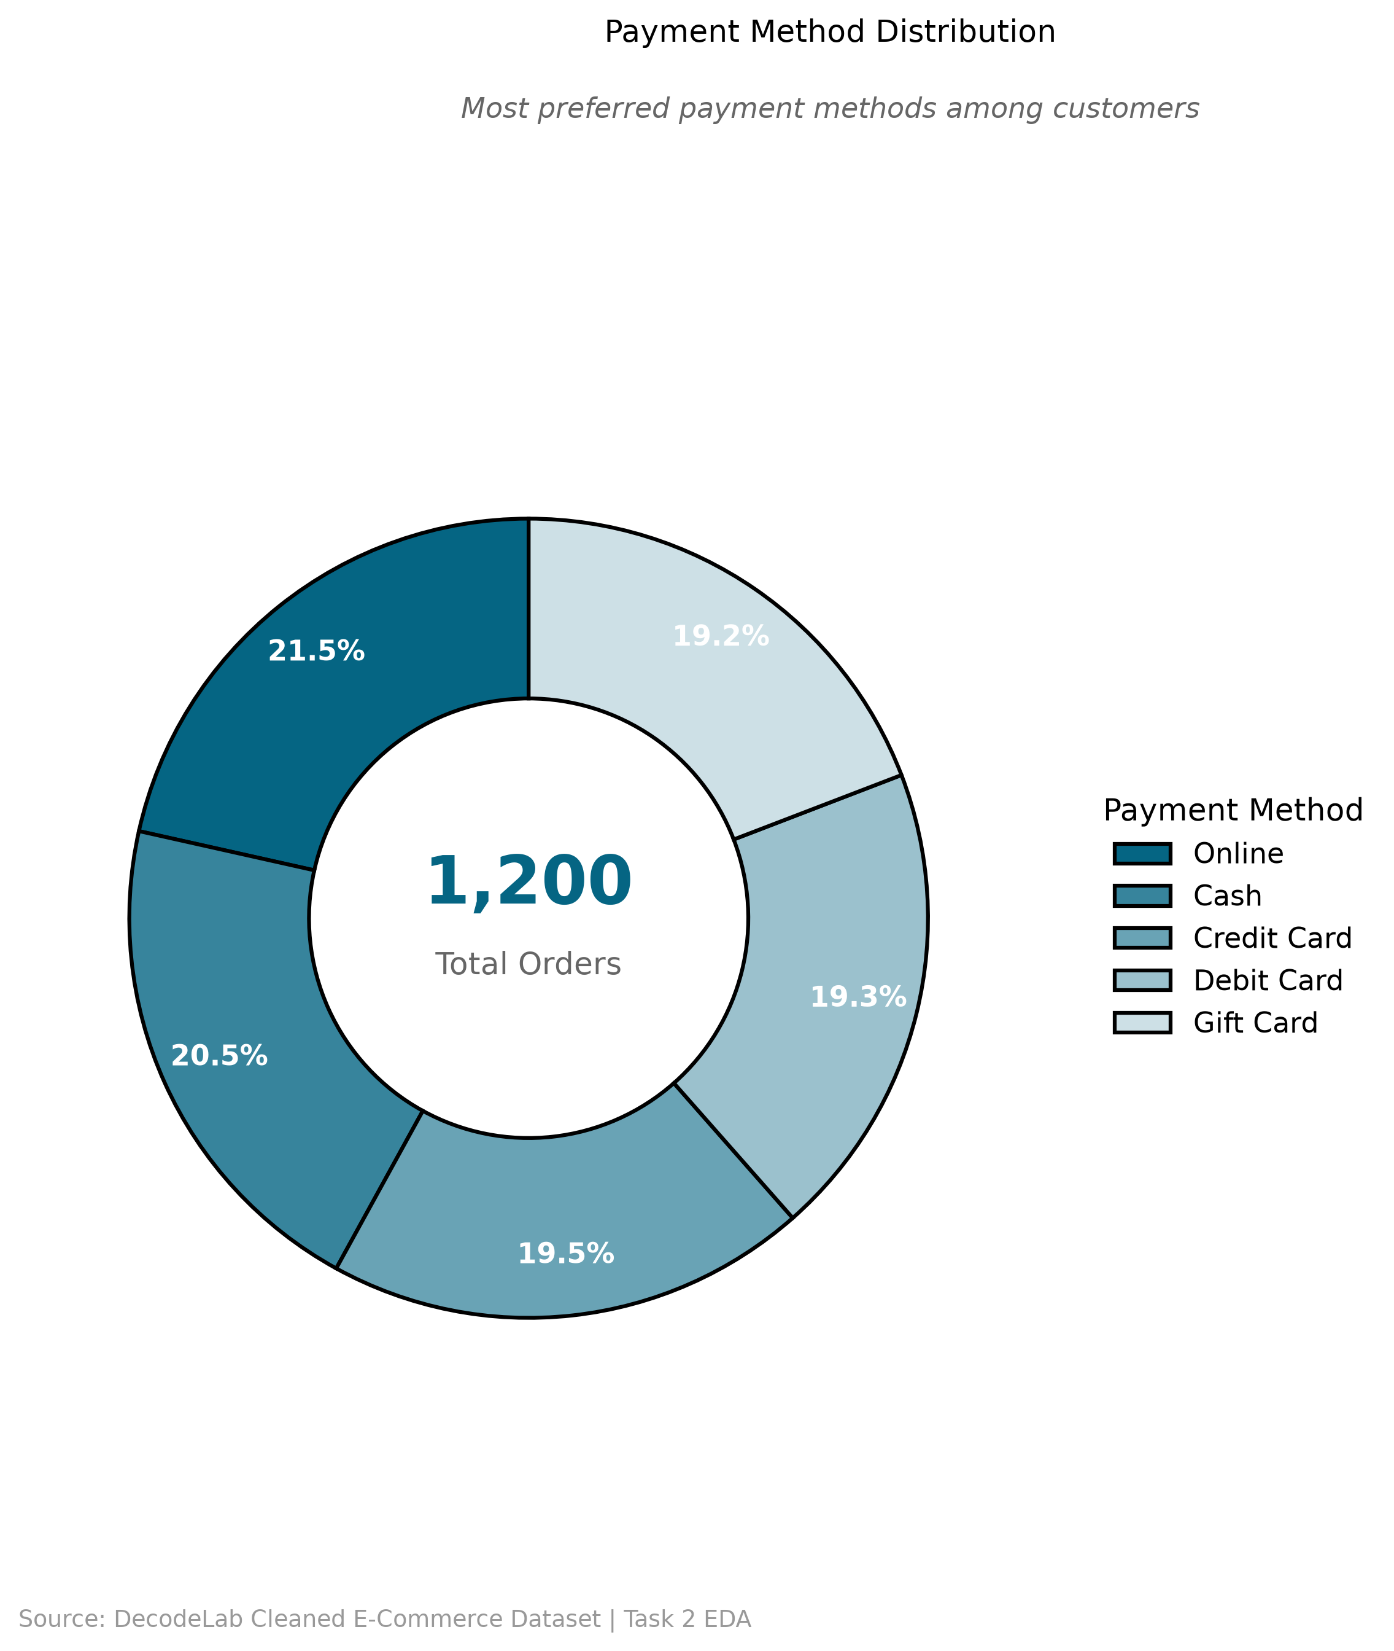
ANALYTICAL NEED: COMPOSITION
No Payment Method Dominates — Online Leads Narrowly
All five options sit within 2.3 points of each other, at roughly 19–22% each.
So What?
Because preference is this evenly split, do not consolidate checkout options. Keep all five — removing any one risks alienating ~1-in-5 customers.
DecodeLabs | E-Commerce Analytics — Project 4
8

Slide 9
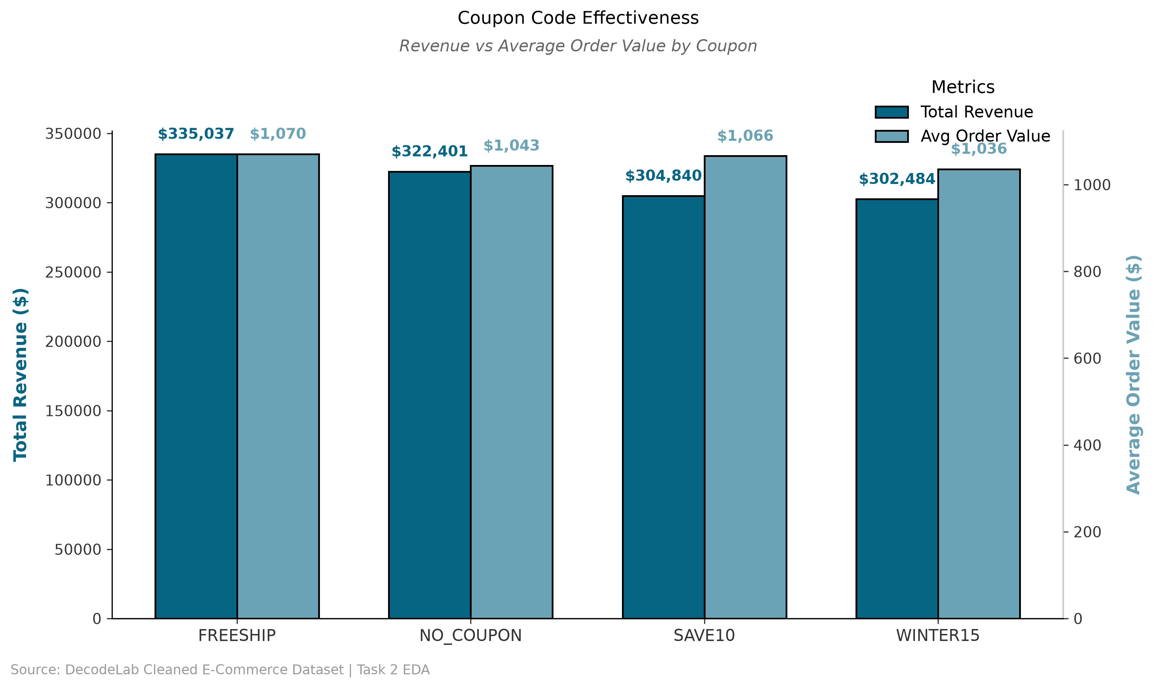
RESOLUTION BEGINS
FREESHIP Beats Every Coupon — Including No Coupon at All
Free shipping drives both the highest total revenue and the highest average order value.
DecodeLabs | E-Commerce Analytics — Project 4
9

Slide 10
RESOLUTION
Four Moves for the Next Quarter
01
02
Fix the return/cancel funnel
Replace SAVE10 / WINTER15 with FREESHIP
Audit checkout & fulfillment for Chair and Printer, the top revenue products, to recover part of the $519K currently lost.
Free shipping already outperforms both discount coupons on revenue and AOV — shift promo budget accordingly.
03
04
Increase Instagram ad spend
Pre-build a Q3 retention campaign
It's the top revenue channel; test a measured budget increase and track incremental orders.
The September dip repeats every year — launch a win-back offer in August, before the drop-off starts.
DecodeLabs | E-Commerce Analytics — Project 4
10

Slide 11
THANK YOU
Questions on methodology, data, or the recommendations are welcome.
Prepared by:
Eman Iqbal — DecodeLabs Data Analytics Internship
decodelabs.tech@gmail.com • www.decodelabs.tech
Greater Lucknow, India

